Slide 1

Comparative Performance Analysis of NAND and NOR Gates Using CMOS and FinFET Technology.
M.F.A Azad Shaon
ID: ET201091
Muhammad Shuaib Chowdhury
ID: ET201058
Supervised by:
Riazul Islam
Lecturer
Department of
Electrical and Electronic Engineering
INTERNATIONAL ISLAMIC UNIVERSITY CHITTAGONG

Slide 2
INTRODUCTION
PROBLEM STATEMENT
OBJECTIVES
Table of Contents
LOGIC GATES AND BOOLEAN FUNCTIONS
LITERATURE REVIEW
INTRODUCTION TO FINFET
CMOS LOGIC STYLES
CIRCUIT DESIGN - CMOS NAND AND NOR GATES USING FinFET

Slide 3
Circuit Design - CMOS NAND and NOR Gates
SIMULATION SETUP
Table of Contents
SIMULATION RESULTS - NAND GATES
PERFORMANCE COMPARISON
CONCLUSION
FUTURE WORK

Slide 4
INTRODUCTION
Logic gates serve as the foundational components in digital electronics, performing essential Boolean operations.
They are crucial for designing microprocessors, embedded systems, digital controllers, and memory devices.
The increasing demand for low-power, high-speed digital circuits has necessitated improvements in gate technology.
This thesis investigates the performance of NAND and NOR gates using traditional CMOS and emerging FinFET technologies.

Slide 5
PROBLEM STATEMENT
CMOS transistors face challenges at technology nodes below 20nm:
  Increased leakage current
  Short-channel effects
  Reduced switching performance
FinFET technology, with its 3D structure and improved gate control, offers a promising alternative.
A detailed comparative study is necessary to assess the suitability of FinFET over CMOS for future digital logic design.

Slide 6
OBJECTIVES
01
To design and simulate NAND and NOR logic gates using both CMOS and FinFET technologies.
02
To examine both static and dynamic logic styles for each gate.
03
To evaluate and compare key performance parameters such as:
Rise time
Fall time
Propagation delay
Power consumption

Slide 7
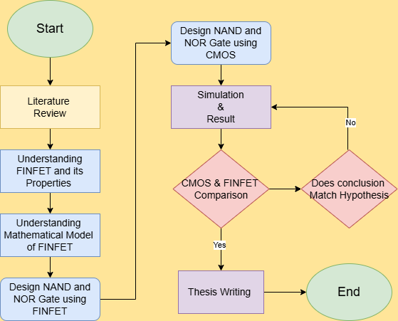
METHODOLOGY

Slide 8
Logic Gates and Boolean Functions
Logic gates perform operations based on Boolean algebra using binary inputs (0 and 1).
NAND Gate: Outputs LOW only if all inputs are HIGH.
NOR Gate: Outputs HIGH only if all inputs are LOW.
These gates are the building blocks for complex circuits like ALUs, multiplexers, and memory cells.
Boolean expressions help formulate the functionality of gates and digital systems.

Slide 9
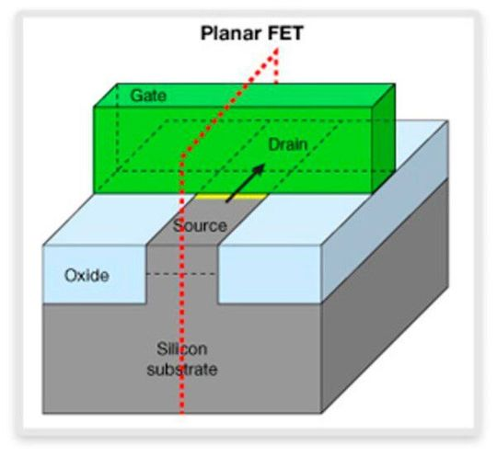
Introduction to FinFET
FinFETs use a fin-shaped channel controlled by gates on multiple sides.
Advantages include:
  Better control over short-channel effects
  Lower leakage current
  Higher drive current
Two types: SOI FinFET and Bulk FinFET
Offers better scalability for sub-20nm nodes

Slide 10
CMOS Logic Styles
Static Logic:
  Uses pMOS and nMOS in complementary fashion
  Stable output maintained without clock
  Low power dissipation when idle
Dynamic Logic:
  Uses clock signals to precharge and evaluate output
  Faster switching but prone to noise and leakage
  Requires precise timing control

Slide 11
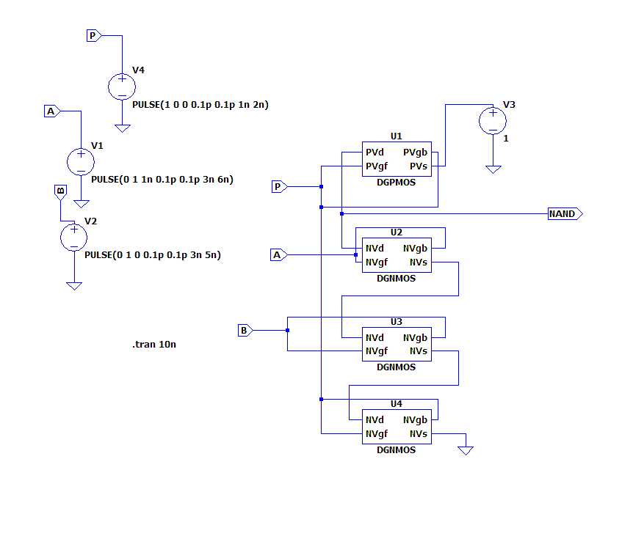
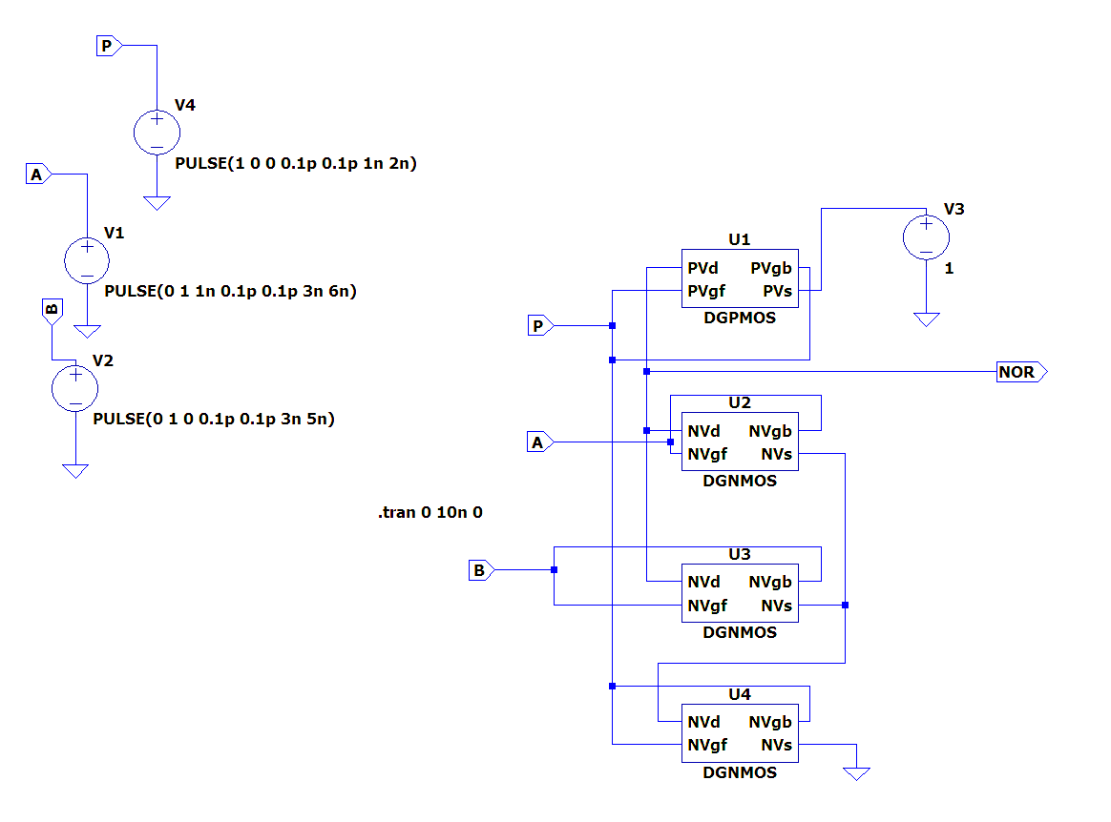
Circuit Design - FinFET NAND and NOR Gates
Gates implemented in LTspice using FinFET models
Utilizes n-type and p-type FinFETs for logic realization
FinFETs reduce delay and power consumption due to 3D gate structure
Fig: 32nm FinFET NAND gate
Fig: 32nm FinFET NOR gate

Slide 12
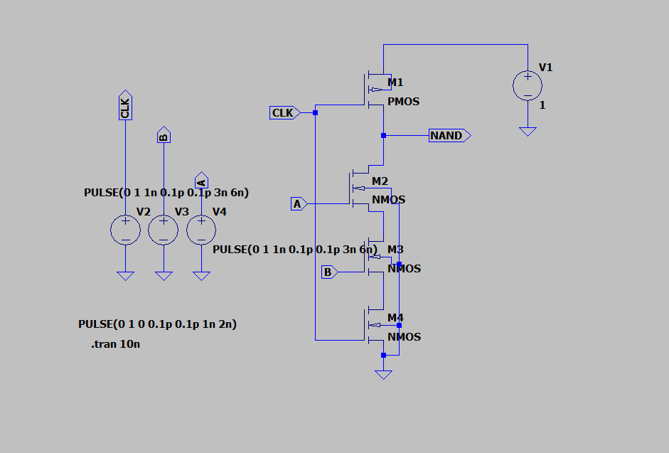
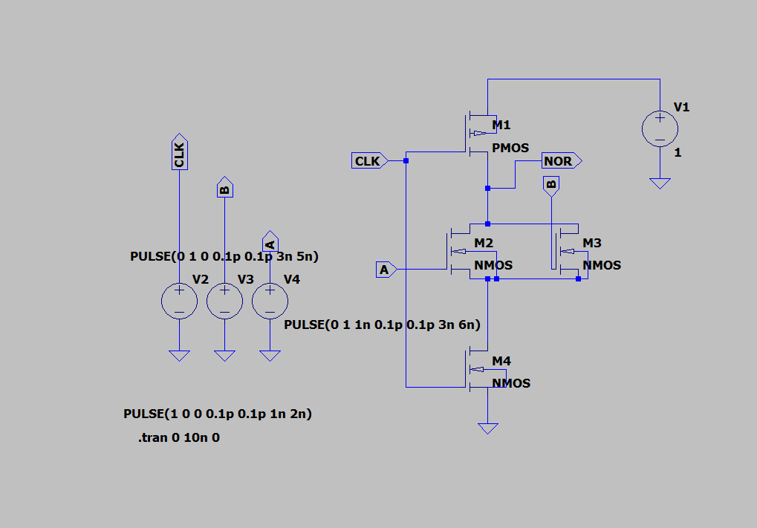
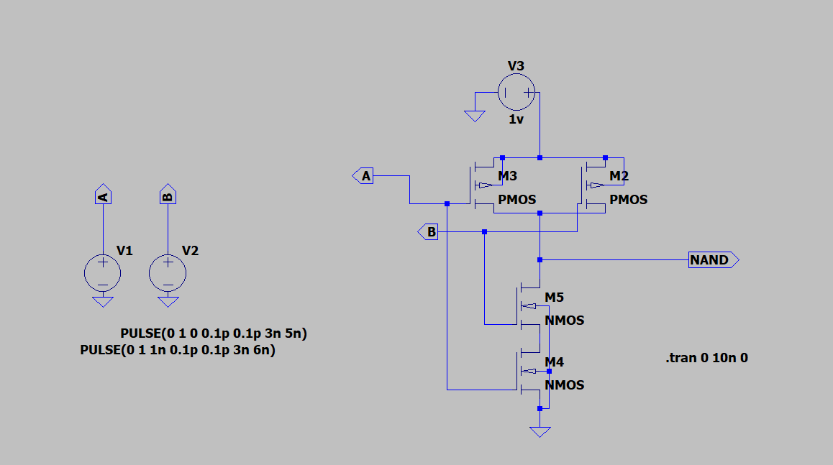
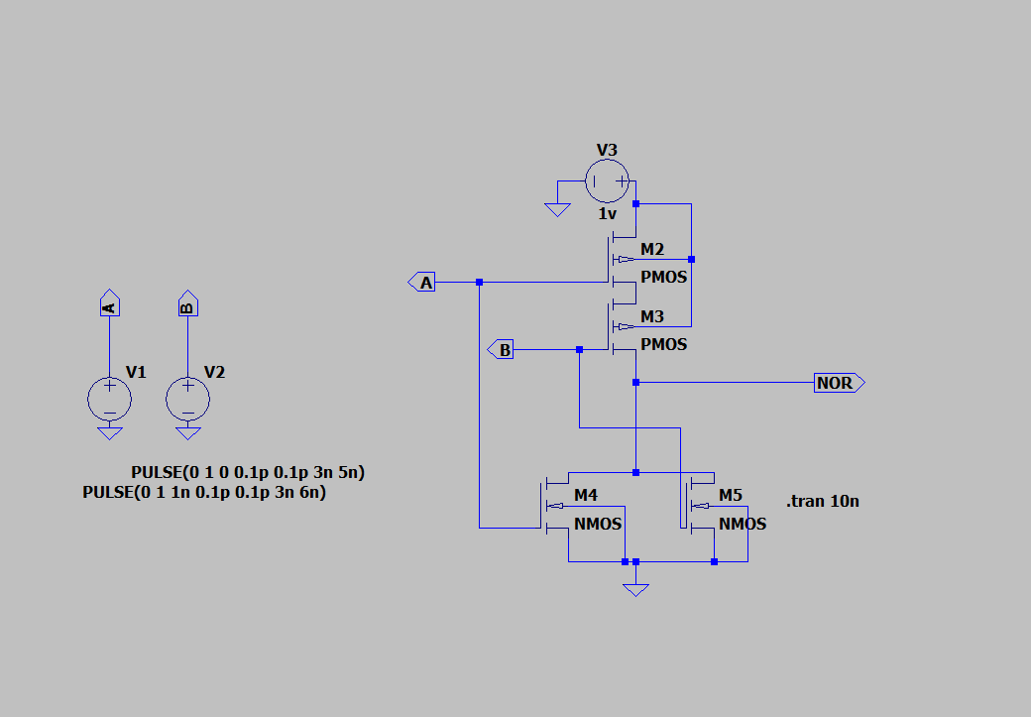
Circuit Design - CMOS NAND and NOR Gates
Both static and dynamic gates designed and simulated
Dynamic CMOS Gates:
  Faster, smaller, but sensitive to clock skew
Static CMOS Gates:
  Reliable and widely used in industry
Fig: Dynamic PTM 32nm CMOS NAND Gates
Fig: Dynamic PTM 32nm CMOS NOR Gates
Fig: Static PTM 32nm CMOS Nand Gates
Fig: Static PTM 32nm CMOS NOR Gates

Slide 13
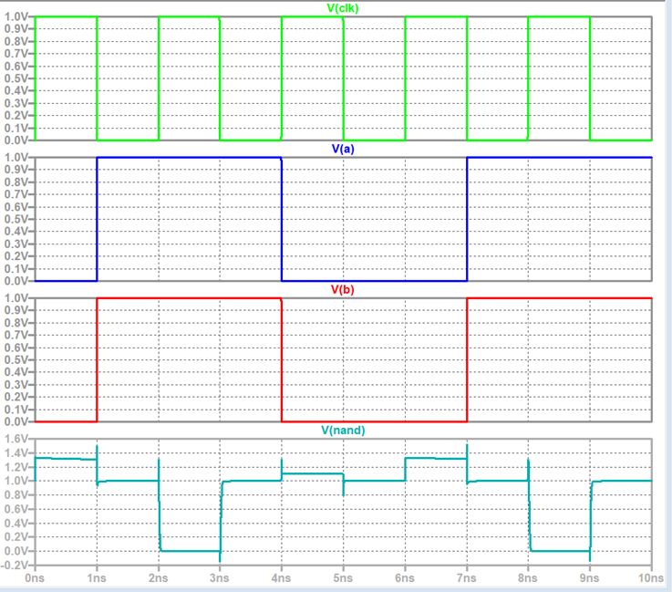
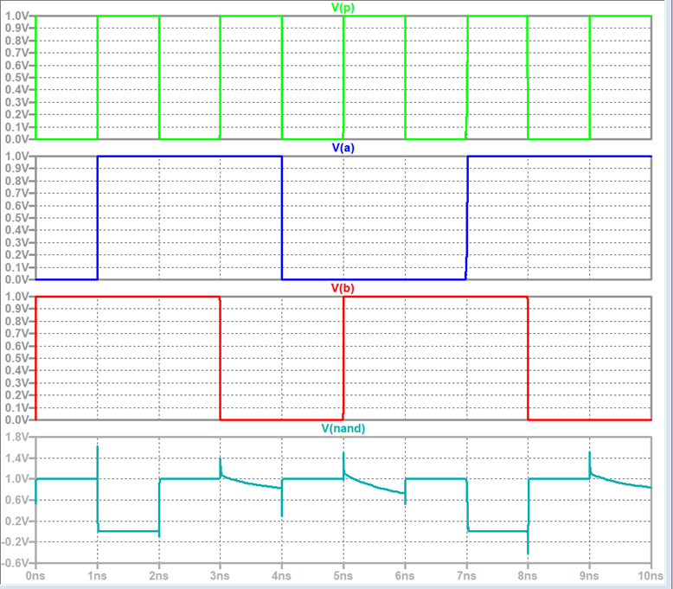
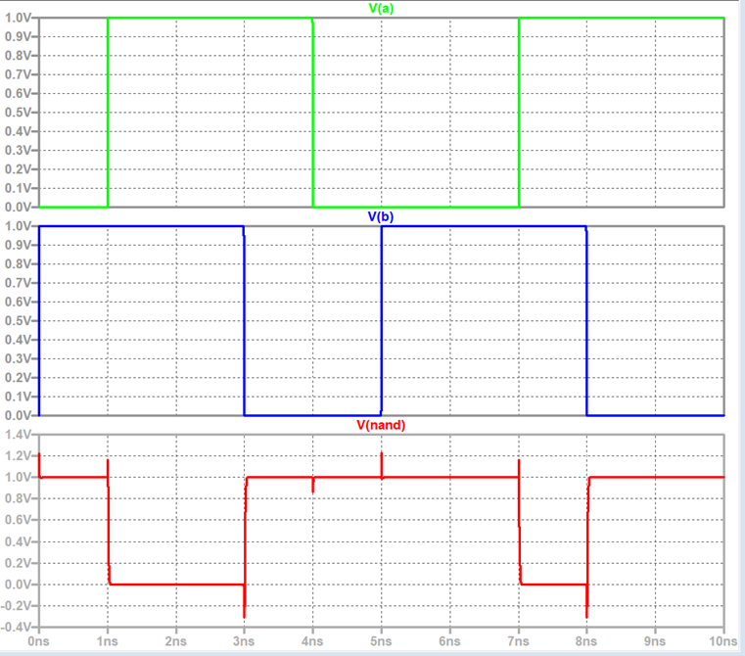
Simulation Results - NAND Gates
Dynamic PTM 32nm CMOS NAND:
  Rise Time: 2.005 ns
  Fall Time: 1.024 ns
  Power: 1.96 nW
Static PTM 32nm CMOS NAND:
  Rise Time: 3.003 ns
  Fall Time: 1.02 ns
  Power: 929 pW
32nm FinFET NAND:
  Rise Time: 7.36 ps
  Fall Time: 6.34 ps
  Power: 3.77 nW

Slide 14
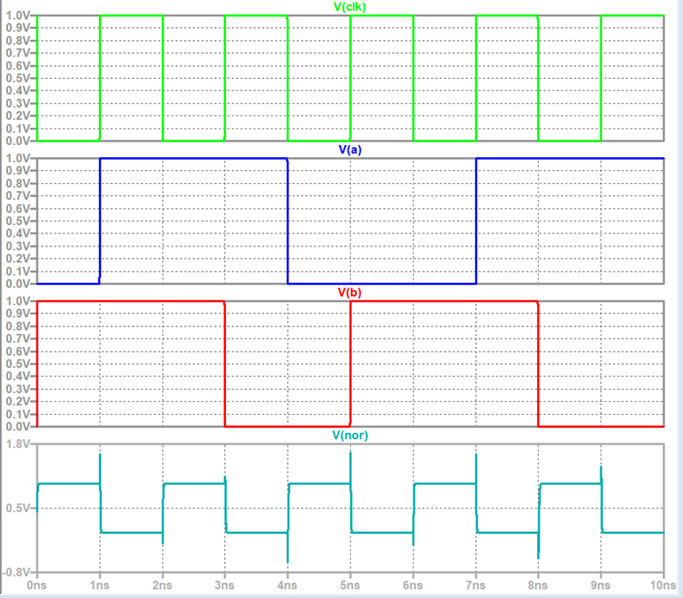
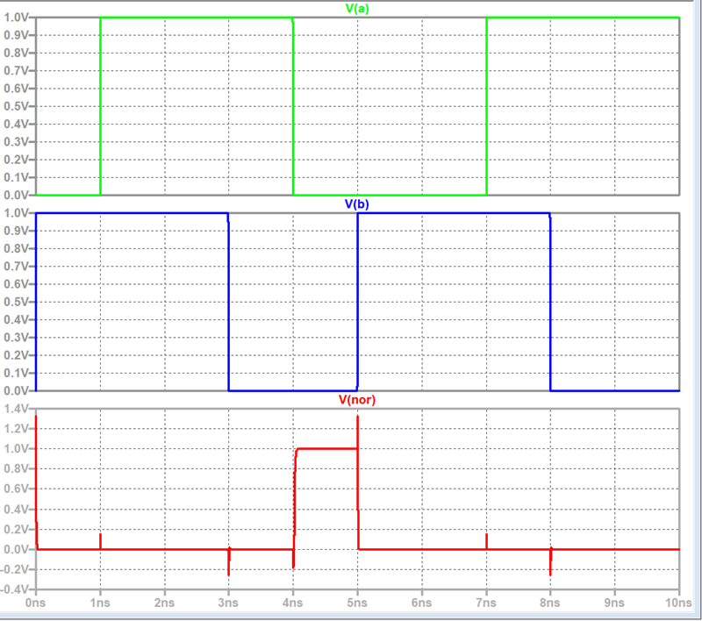
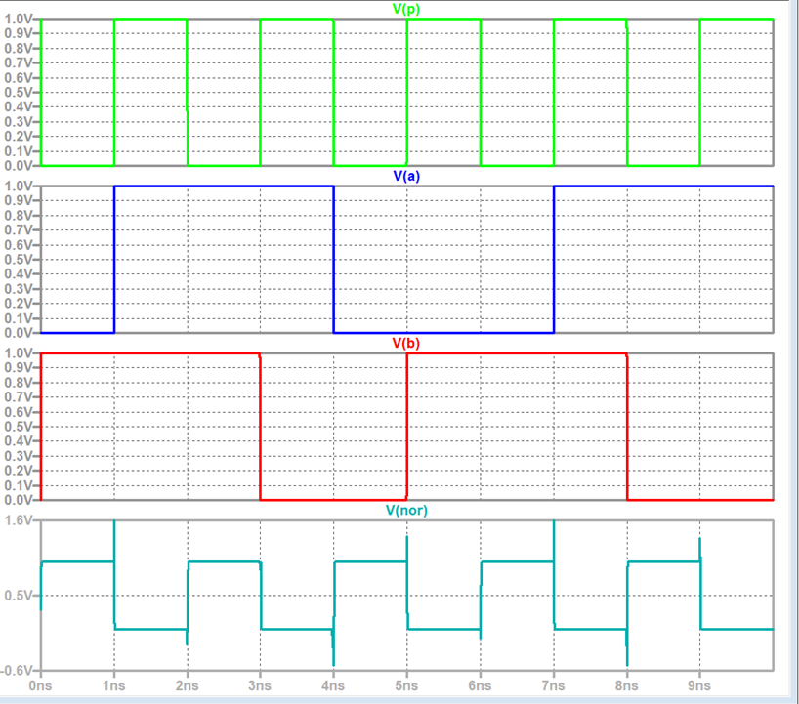
Simulation Results - NOR Gates
Dynamic PTM 32nm CMOS NOR:
  Rise Time: 4.99 ns
  Fall Time: 3.98 ns
  Power: 1.25 nW
Static PTM 32nm CMOS NOR:
  Rise Time: 1.00 ns
  Fall Time: 9.3 ps
  Power: 1.39 nW
32nm FinFET NOR:
  Rise Time: 8.41 ps
  Fall Time: 3.57 ps
  Power: 5.39 nW

Slide 15
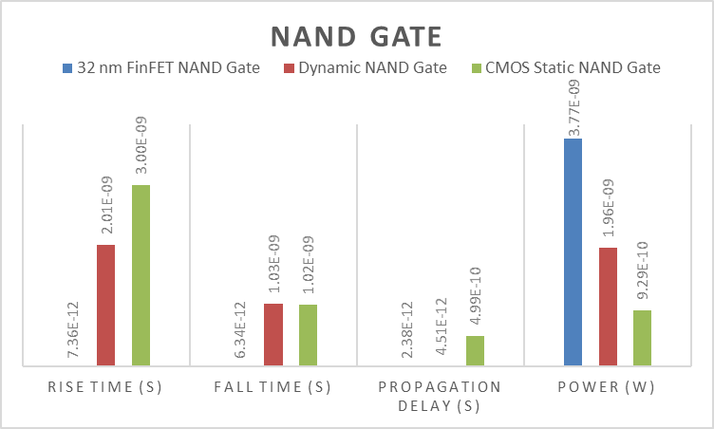
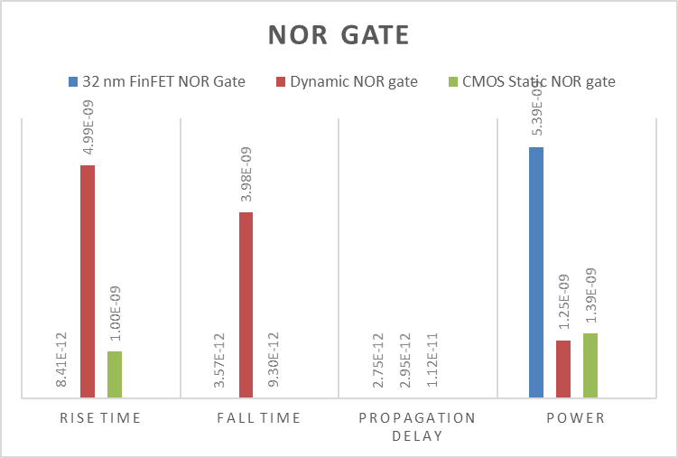
Performance Comparison
Comparison of all six configurations
FinFET shows fastest switching and lowest delay
CMOS Static is more power-efficient but slower
Dynamic CMOS is fast but consumes more power
Properties | Rise Time | Fall Time | Propagation Delay | Power
32nm FinFET NOR Gate | 8.41E-12 | 3.57E-12 | 2.75E-12 | 5.39E-09
PTM 32nm CMOS Dynamic NOR Gate | 4.99E-09 | 3.98E-09 | 2.95E-12 | 1.25E-09
PTM 32nm CMOS Static NOR Gate | 1.00E-09 | 9.30E-12 | 1.12E-11 | 1.39E-09
32nm FinFET NAND Gate | 7.36E-12 | 6.34E-12 | 2.38E-12 | 3.77E-09
PTM 32nm CMOS Dynamic NAND Gate | 2.01E-09 | 1.02E-09 | 4.51E-12 | 1.96E-09
PTM 32nm CMOS Static NAND Gate | 3.00E-09 | 1.02E-09 | 4.99E-10 | 9.29E-10

Slide 16
Key Findings
FinFET gates demonstrate:
  Faster switching due to better gate control
  Reduced leakage and better subthreshold swing
  Suitable for high-speed, low-power applications
CMOS still viable for cost-sensitive applications

Slide 17
Conclusion
CMOS faces scalability and performance limitations
FinFET technology addresses these with superior design
For future VLSI design, FinFET offers better performance and efficiency
LTspice simulations confirm performance gains in FinFET-based designs

Slide 18
Future Work
Study FinFET gates under varied temperatures and voltages
Analyze integration into larger digital blocks (e.g., ALUs)
Explore hybrid logic families for ultra-low power designs
Investigate real-time implementations using FPGA or ASIC platforms
Evaluate FinFET performance in logic-intensive circuits like full adders or multiplexers
Explore noise immunity and signal integrity analysis in FinFET vs CMOS
Extend simulations to 3nm and beyond to analyze scalability

Slide 19
THANK
YOU

